Slide 1
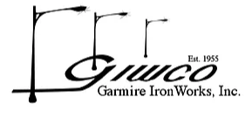
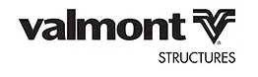
Manufacturer’s representative Serving Washington State and Northern Idaho*
Specialists in Outdoor Lighting, All Things Poles, and Lighting Controls
www.pnwlts.com 206-944-1818
Alaskan cedar wood light poles – pest resistant
EXTERIOR ONLY – Retrofits & Decorative
Roadway & Outdoor LED Light Fixtures & Controls
Solar Street & Area Lighting & Pedestrian Safety
Light poles, ped poles, specialty poles and light arms
Popular Canadian Style LED lighting & Solutions
Area Lights, Decorative Post tops, & LED Retrofits
Largest Outdoor Decorative Lighting Line
Global Leader in tunnel lighting & modern LED lights
Leader in traffic & light Poles, EV Charging, & MORE
Optimal NW solution – Vertical Solar Wrap
Roadway, Municipal, Utility Only
European Designs Manufactured in USA
High Quality Fiberglass & Composite poles & bases
*Some products are not available in all channels or geographies served

